Slide 1
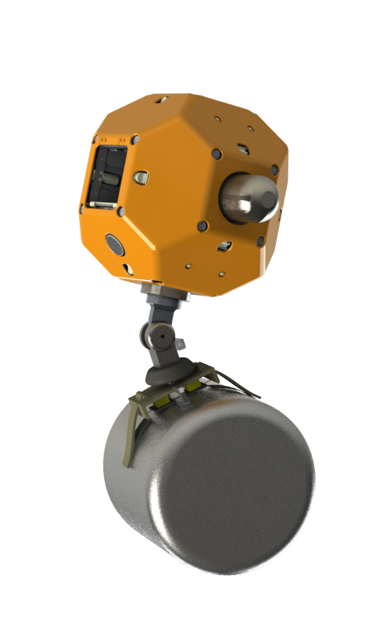
Control of an Active Wrist for a Gecko-Inspired Adhesive Gripper
Negin Heravi, Matt Estrada
Stanford University
September 26, 2017

Slide 2
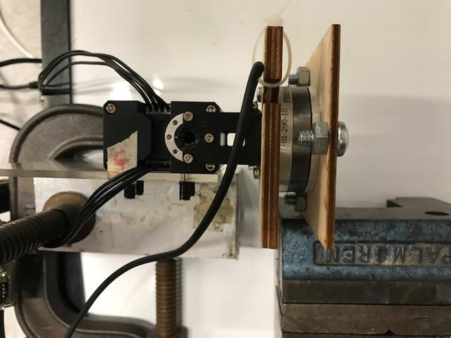
Dynamixel Current control – Set up
* Dynamixel is what In Won is using so it will port to Astrobee well.
2

Slide 3
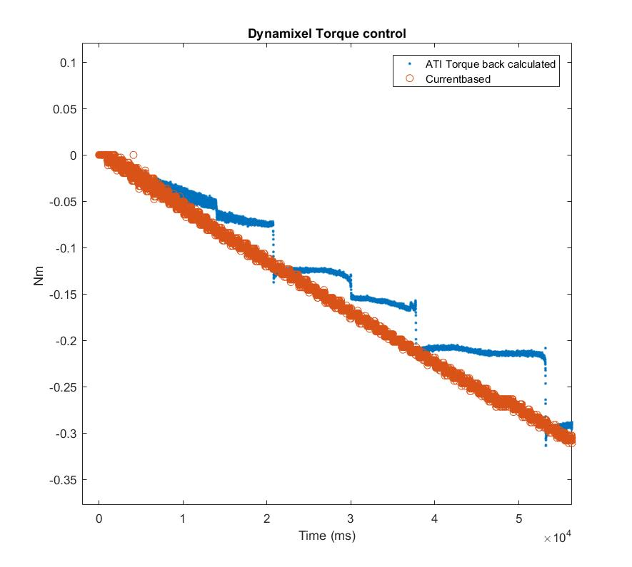
Dynamixel Current control
* There seems to be unexplained jumps in ATI data
3

Slide 4
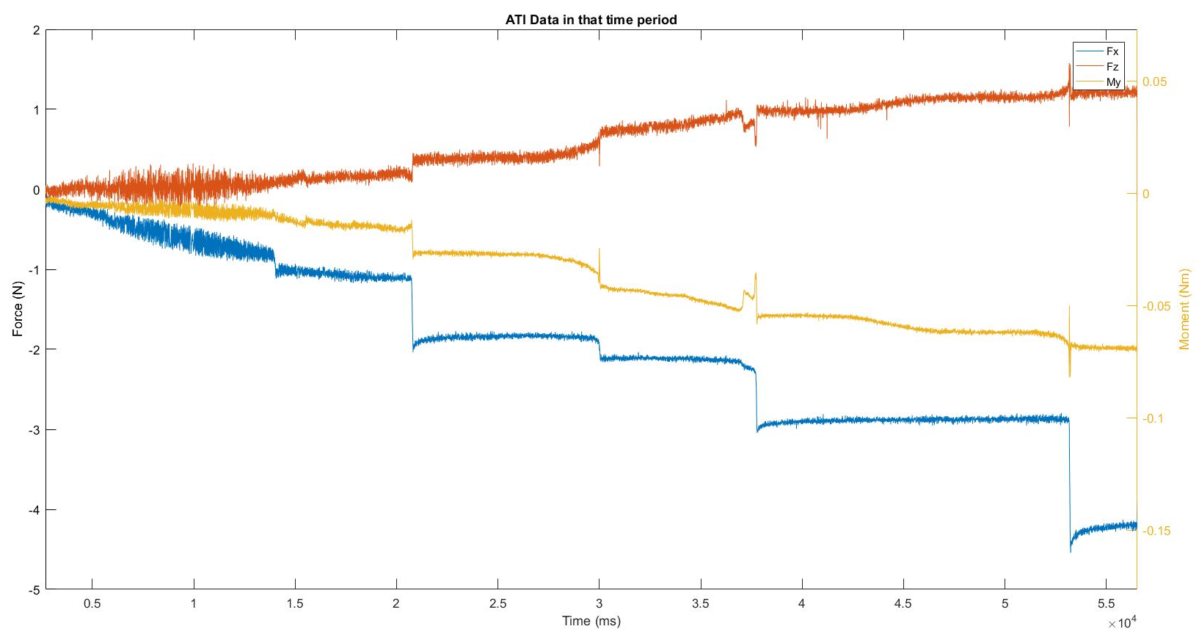
Dynamixel Current control
* Despite the continuous commanded torque sensor data seems chunked.
4

Slide 5
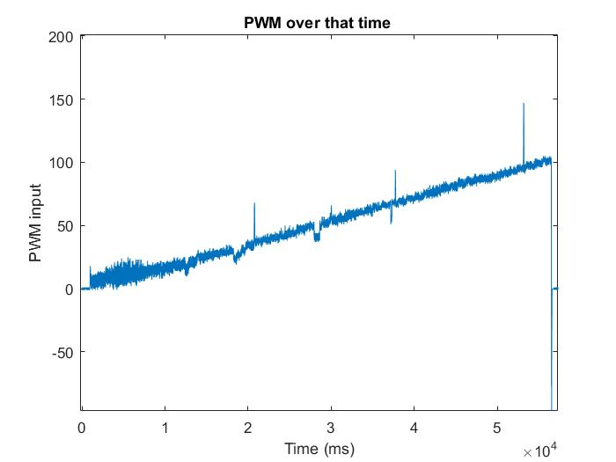
Dynamixel Current control
* The jumps seem to be correlated to jumps in PWM data.
5

Slide 6
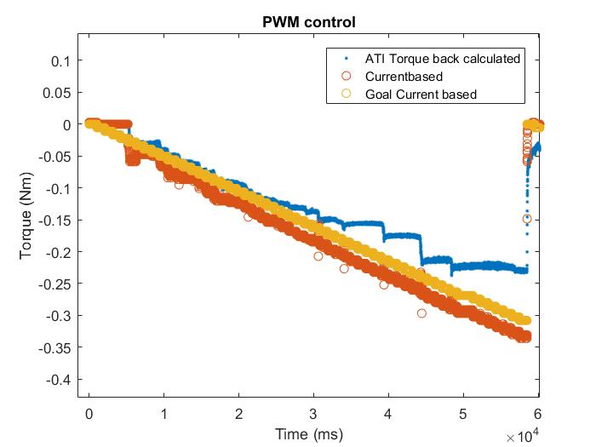
PWM control
* To assess the source of the problem the motor was run in PWM control and similar problem
was observed …..
6

Slide 7
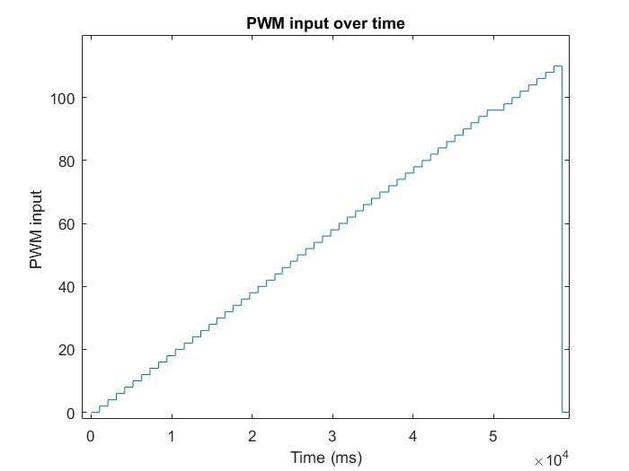
Dynamixel Current control
* Currently talking with the company to find the source of the problem
* Maybe the motor is somehow getting stuck?
7

Slide 8
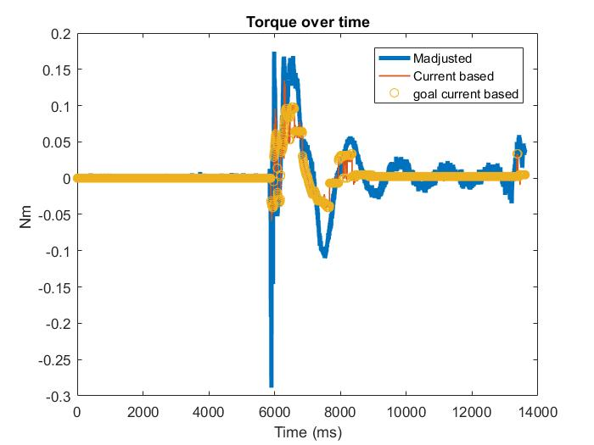
Impedance control
8

Slide 9
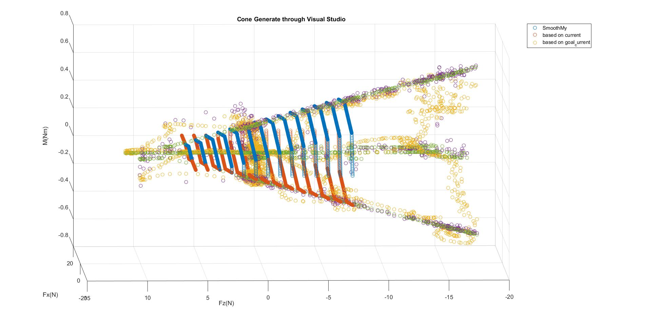
Riding the Cone Test
Object was moved around with hand
9

Slide 10
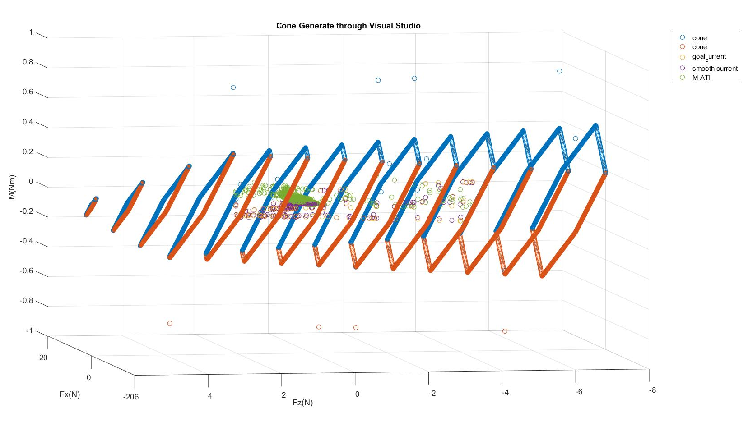
Real Catch Scenario
80 % seems like a reasonable safety factor (this is very hand-wavy) more extensive study should be done
to have a definite number.
10

Slide 11
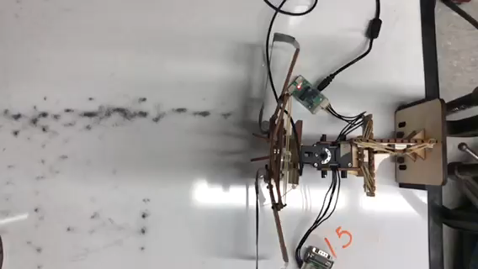
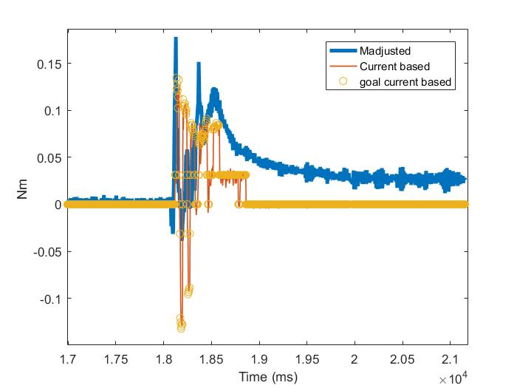
Torque Data Match in Catching
11

Slide 12
EOM
To be added
12

Slide 13
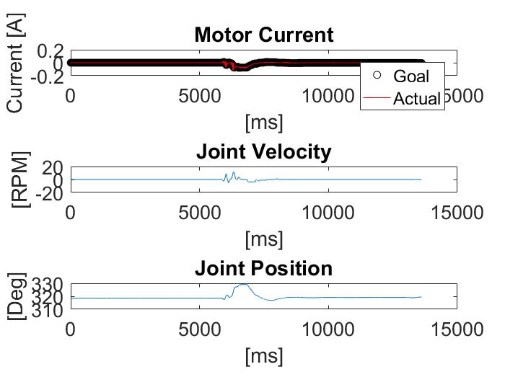
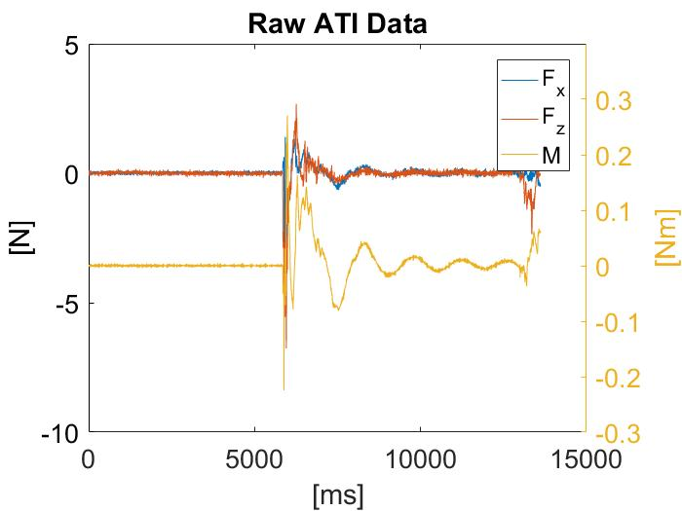
Impedance control- Extra slide
13

Slide 14
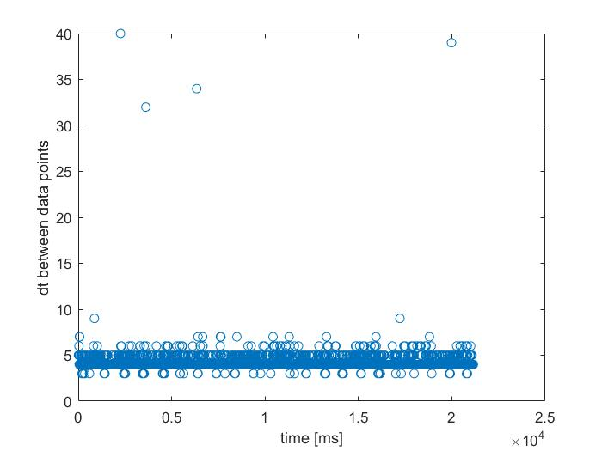
Extra slide
14

Slide 15
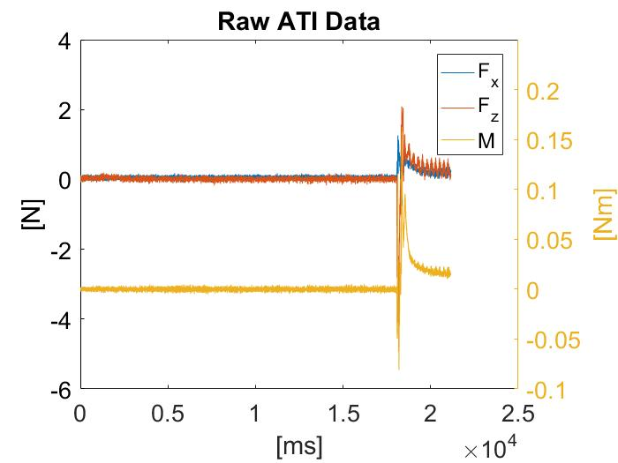
Extra slides
15

